Slide 1



Road Accidents Analysis
View in Power BI
Last data refresh:
02/05/2024 12:23:49 UTC
Downloaded at:
02/05/2024 12:29:17 UTC

Slide 2
2023 Road Accident Report
Presented by: Funmilayo Raphael

Slide 3
Content
Introduction
Project Overview
The Goal of the Project
Problem Statement
Insights From Exploratory Analysis
Dashboard
Recommendation
Conclusion

Slide 4
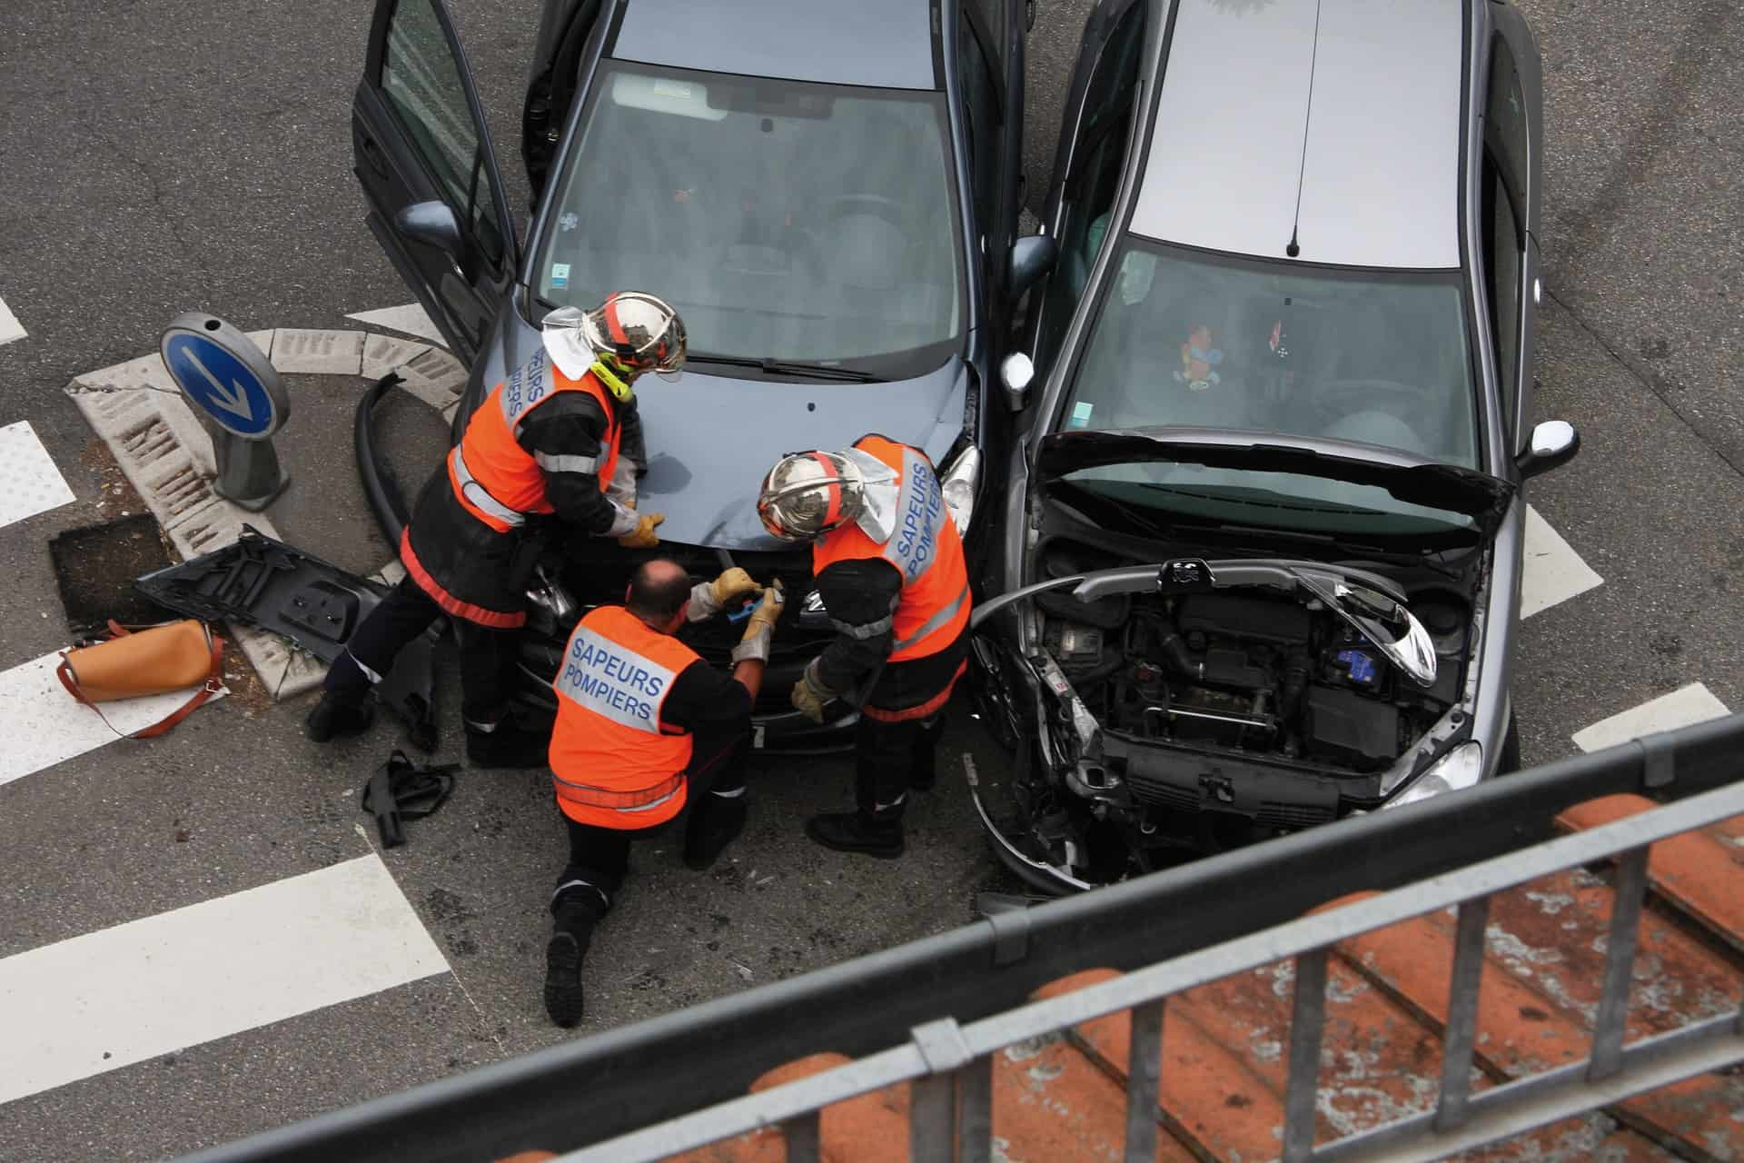
Introduction
In today's fast-paced world, road safety remains a critical concern for both individuals and communities.
Every year, thousands of lives are lost and countless others are impacted by road accidents.
It is a paramount responsibility to harness the power of data to understand the dynamics of road accidents comprehensively.

Slide 5

Project Overview
The analysis of road accidents entails a multifaceted approach that involves delving into various dimensions of the data collected. Factors such as the geographical distribution of accidents, road conditions, weather patterns, and severity of injuries incurred will be explore.
The aim of this Exploratory Data Analysis process is to develop a nuanced understanding of the factors contributing to road accidents and their relative significance.

Slide 6

The Goal of the Project
The goal of this analysis is to gain insights into the causes of road accidents and develop strategies for accident prevention and mitigation.

Slide 7
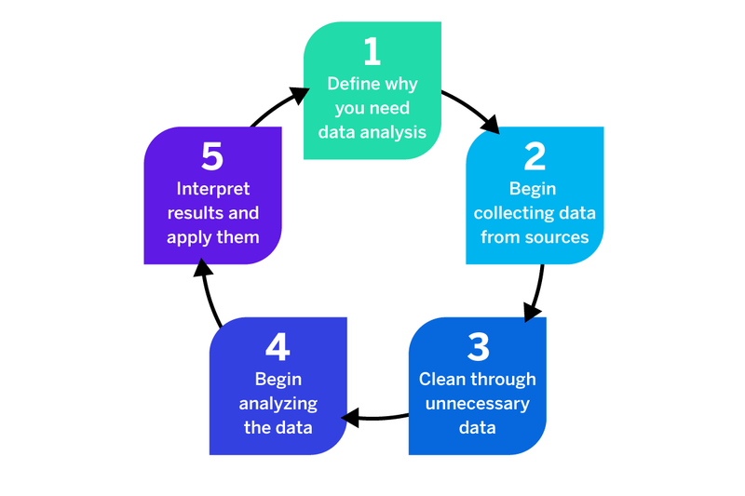
Analysis Approach

Slide 8

Problem Statement
The lack of a comprehensive understanding of the underlying causes and contributing factors hampers the ability to devise targeted interventions and strategies for accident prevention.
How can we leverage data-driven insights to identify patterns, trends, and contributing factors related to road accidents, and subsequently develop effective strategies for accident prevention and mitigation?

Slide 9
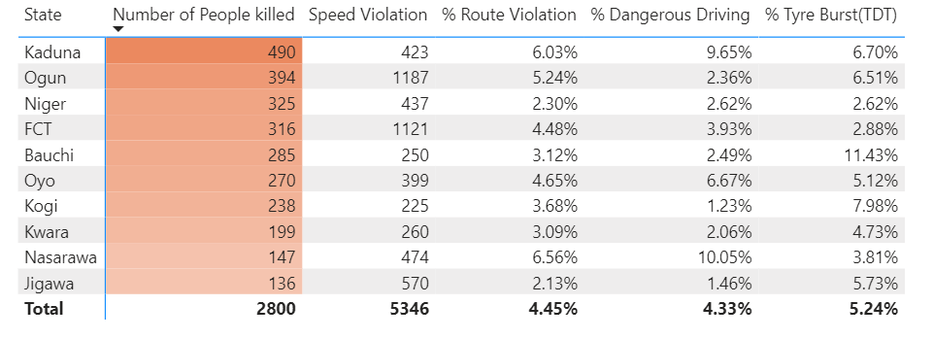
Insights
In the analysis, it was observed that speed violation has the highest cause of road across the 36 states and FCT.
From the data under review Kaduna State had the highest number of people that died as a result of road accidents.
The table beside shows that Ogun State had the highest number of speed violation but Kaduna state had 490 people killed in road accident in 2023.
The top causes of accidents in Kaduna include includes Speed Violation, Route Violation, Dangerous Driving and Tyre Burst(TDT) as far as this analysis is concerned.

Slide 10
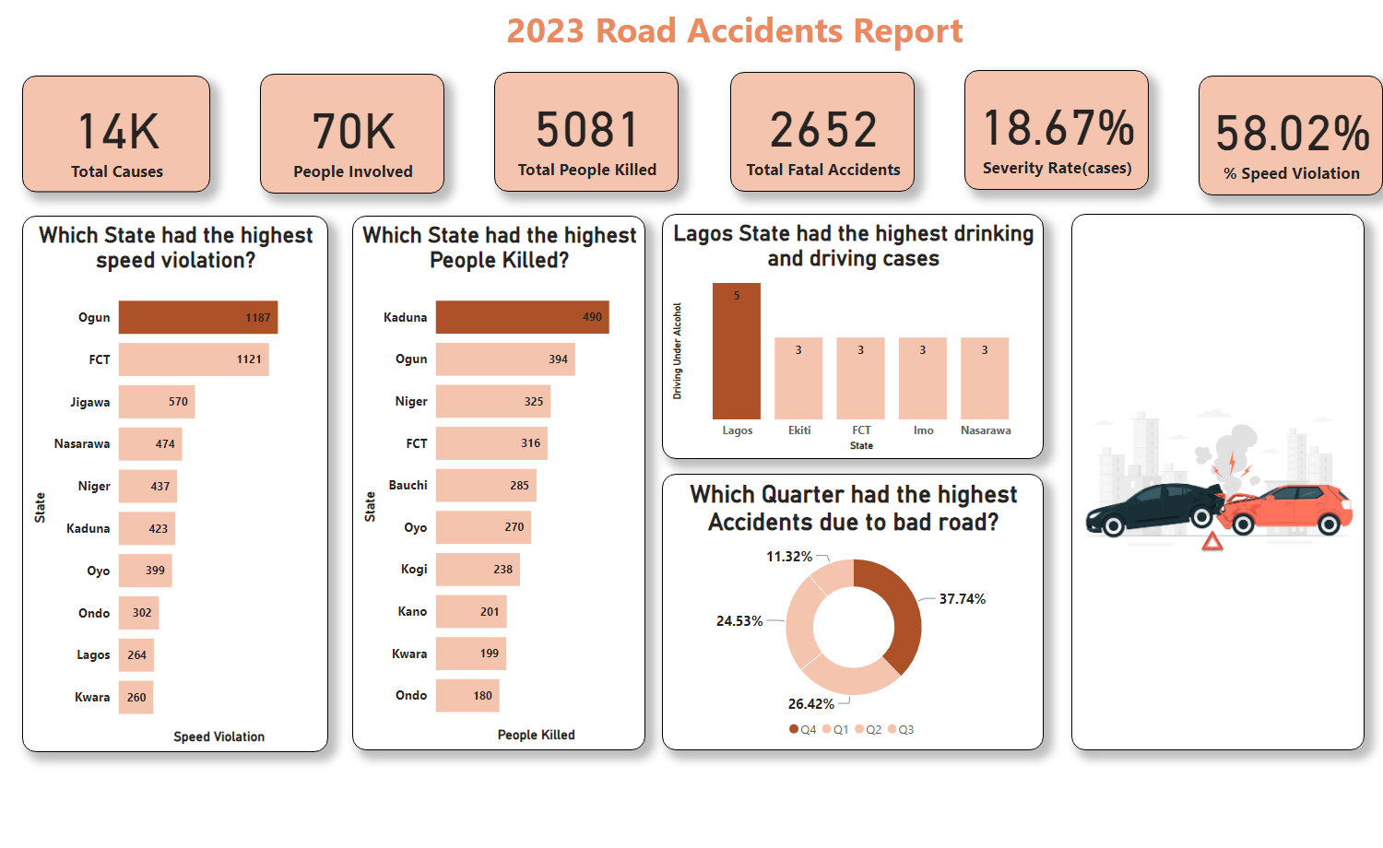
Dashboard
Notes:
textbox
No alt text provided
card
No alt text provided
card
No alt text provided
card
No alt text provided
Which Quarter had the highest Accidents due to bad road?
No alt text provided
Lagos State had the highest drinking and driving cases
No alt text provided
card
No alt text provided
card
No alt text provided
image
No alt text provided
card
No alt text provided
Which State had the highest speed violation?
No alt text provided
Which State had the highest People Killed?
No alt text provided

Slide 11
Recommendation
Since speed violation is identified as a significant contributing factor, it's imperative to implement targeted enforcement measures and awareness campaigns in Kaduna and other States. Law enforcement agencies can increase patrols and enforcement of speed limits on key highways and roads especially in Kaduna.
Identify specific locations where road accidents are most frequent and severe. This could involve conducting detailed investigations into the infrastructure, traffic patterns, and other factors contributing to accidents at these hotspots.
Develop and implement comprehensive road safety education and training programs in Kaduna, Ogun, Jigawa, Nasarawa and FCT, focusing on addressing the top causes of accidents identified in the analysis, including speed violation, route violation, dangerous driving, and tyre burst. These programs can target not only drivers but also pedestrians and other road users

Slide 12
Conclusion
The analysis of this road accidents data highlights significant trends and challenges in road safety, particularly in Kaduna, Ogun, Jigawa, Nasarawa and FCT where speed violation emerges as the primary cause of accidents.
Despite Ogun State recording the highest number of speed violations, Kaduna stands out with the highest number of fatalities in 2023.
The top causes of accidents in Kaduna include speed violation, route violation, dangerous driving, and tyre burst.
To address these issues, targeted interventions such as enforcement measures, awareness campaigns, infrastructure improvements, and comprehensive road safety education programs are recommended.
By prioritizing these initiatives, stakeholders can work towards reducing road accidents and fatalities, ultimately enhancing safety for all road users.

Slide 13


Slide 14


